Slide 1

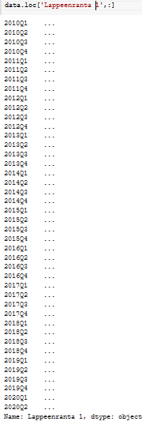




Terraced houses EDA

Slide 2



Terraced houses EDA

Slide 3
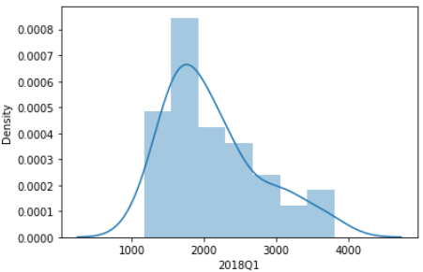
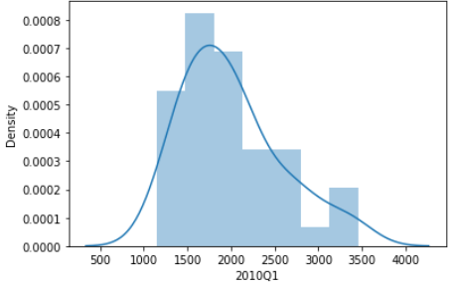
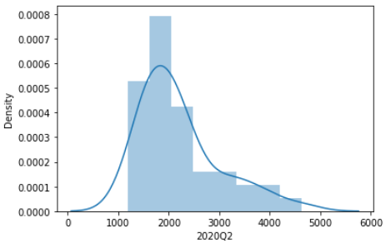
Terraced houses EDA

Slide 4
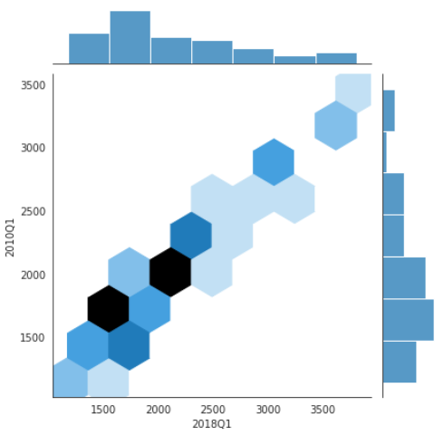
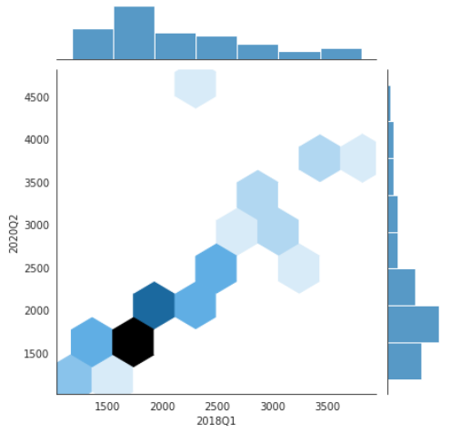
Terraced houses EDA

Slide 5



Terraced houses EDA
Mean diff btw 2010 Q1 & 2020Q2 = 198,17
Std diff btw 2010 Q1 & 2020Q2 = 225,26

Slide 6


One-room flat EDA
Mean diff btw 2010 Q1 & 2020Q2 = 610,73
Std diff btw 2010 Q1 & 2020Q2 = 698,41

Slide 7
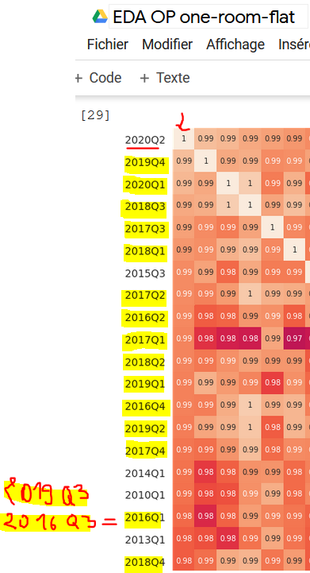
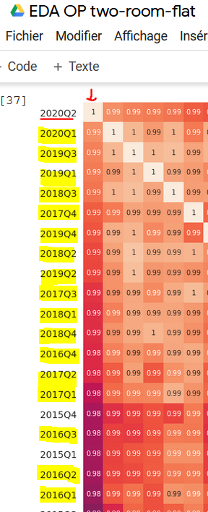
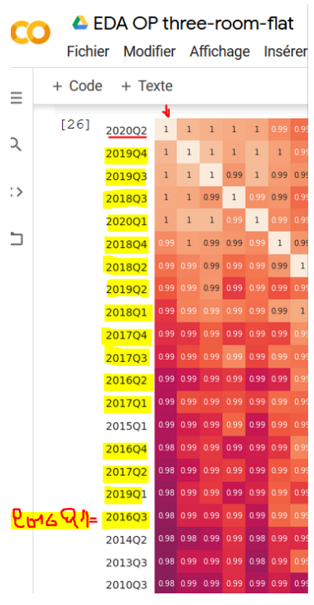
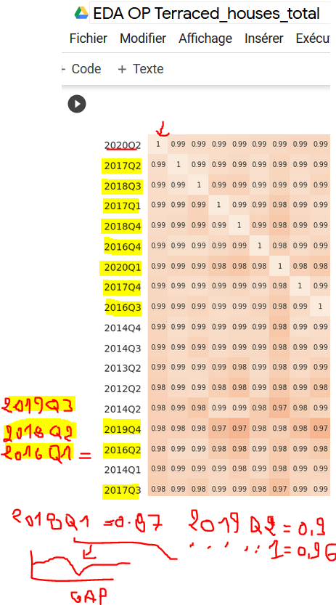
Correlations

Slide 8


Terraced houses EDA

Slide 9
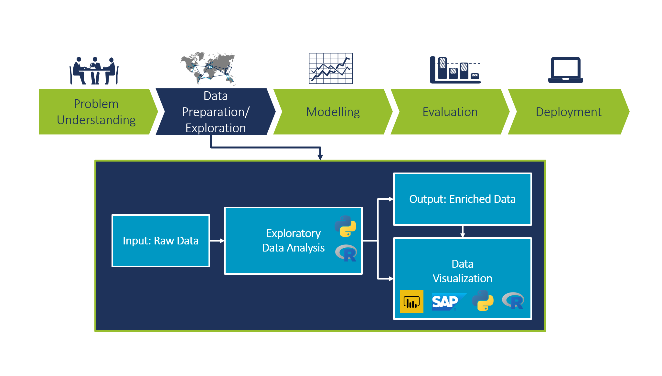
Where we are now:

